Slide 1
Agenda
BPMN what and target
BPMN basic concept
Useful tools
ONAP BPMN flow Example (VoLTE)

Slide 2
What is BPMN
A standard Business Process Model and Notation (BPMN) will provide businesses with the capability of understanding their internal business procedures in a graphical notation and will give organizations the ability to communicate these procedures in a standard manner.
The unified modelling language (UML) takes an object-oriented approach to the modeling of applications
BPMN takes a process-oriented approach to modelling of systems
Notes:
What is the relationship between BPMN and BPEL?
BPEL is an XML-based language for describing a business process in which most of the tasks represent interactions between the process and external Web services. The BPEL process itself is represented as a Web service, and is realized by a BPEL engine which executes the process description. BPMN is a standard set of diagramming conventions for describing business processes. It is designed to visualize a rich set of process flow semantics within a process and the communication between independent processes. It is intended to support capture of sufficient detail to allow it to be the source of an executable process description. Since BPEL is currently considered the most important standard for execution languages, a translation to BPEL is specified in the BPMN standard. By design there are some limitations on the process topologies that can be described in BPEL, so it is possible to represent processes in BPMN that cannot be mapped to BPEL. There are a few concepts, such as Ad-Hoc sub-proceses, that BPMN can represent that may not be implemented with any technology.

Slide 3
Who is BPMN targeted at?
BPMN is targeted at a high level for business users and at a lower level for process implementers.
The business users should be able to easily read and understand a BPMN business process diagram.
The process implementer should be able to adorn a business process diagram with further detail in order to represent the process in a physical implementation.
BPMN is targeted at users, vendors and service providers that need to communicate business processes in a standard manner.

Slide 4
Basic concepts
Five categories of elements
Flow Object
Events, Activities, Gateways
Data
Objects, Inputs, Output, Stores
Connection Objects
Sequence, message, associations
SwimLanes
Pools, Lanes
Artifacts
Group, Text Annotation

Slide 5

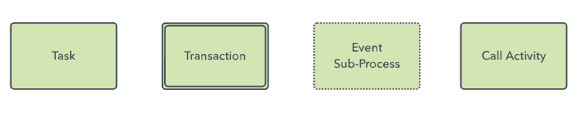

Useful items of Flow

Slide 6
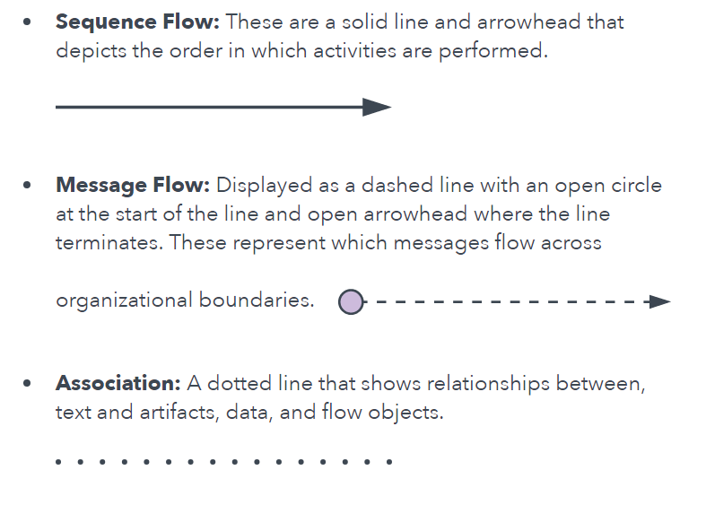
Useful items of Connection

Slide 7

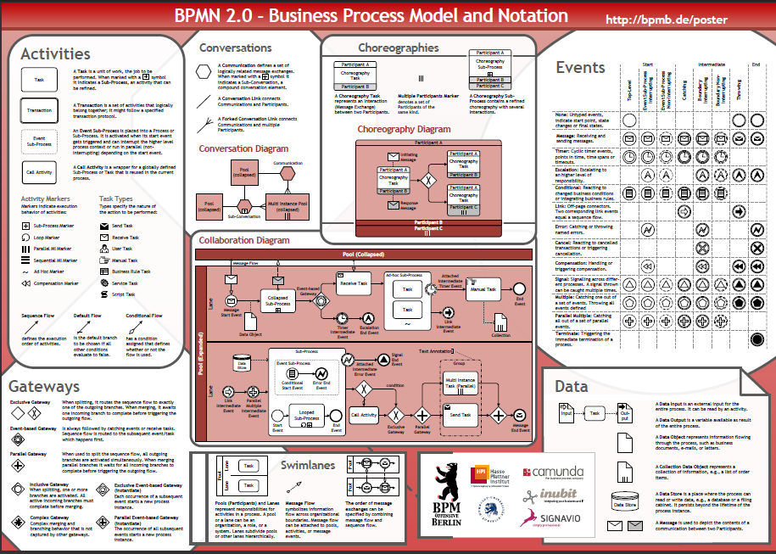
BPMN Poster: get it from blackboard!

Slide 8
SO BPMN File ARCH(take vCPE as example)
Main flow(top-level flow):
src/main/resources/process/CreateVcpeResCustService.bpmn
Subprocess flow(invoked by main or subprocess flow):
src/main/resources/subprocess/DoCreateServiceInstance.bpmn, DoCreateAllottedResourceTXC.bpmn
Groovy script for each BPMN file. Invoked by script tasks within flow:
src/main/groovy/org/openecomp/mso/bpmn/vcpe/scripts/CreateVcpeResCustService.groovy
Unit Tests for every flow:
src/test/java/org/openecomp/mso/bpmn/vcpe/CreateVcpeResCustServiceTest.java
Unit Tests resource files
src/test/resources/__files/VCPE/CreateVcpeResCustServicecd/*.xml, *.json

Slide 9
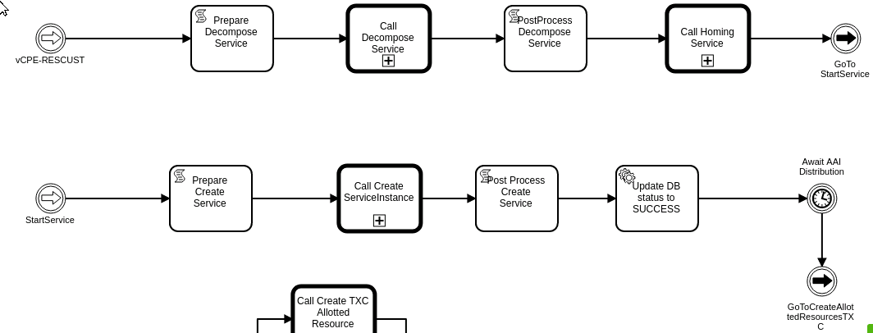

CreateVcpeResCustService.bpmn level1

Slide 10
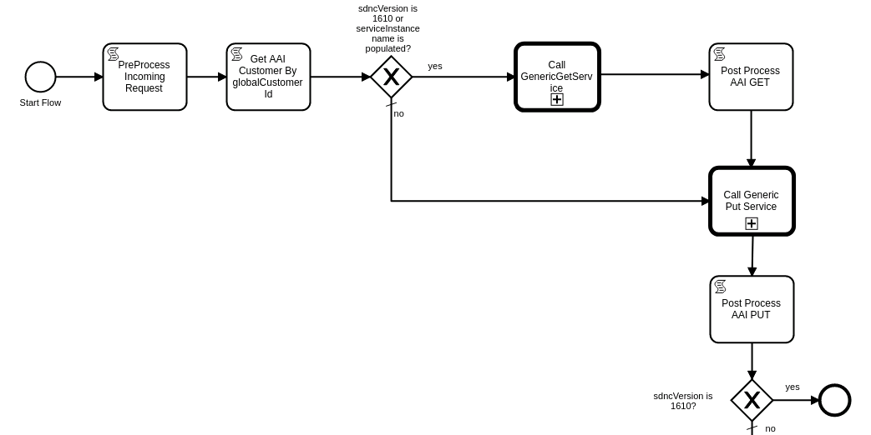
DoCreateServiceInstance.bpmn level2
#{(execution.getVariable("serviceInstanceName" ) != null && execution.getVariable("serviceInstanceName" ) != "" ) || execution.getVariable("sdncVersion" ) == "1610" }

Slide 11
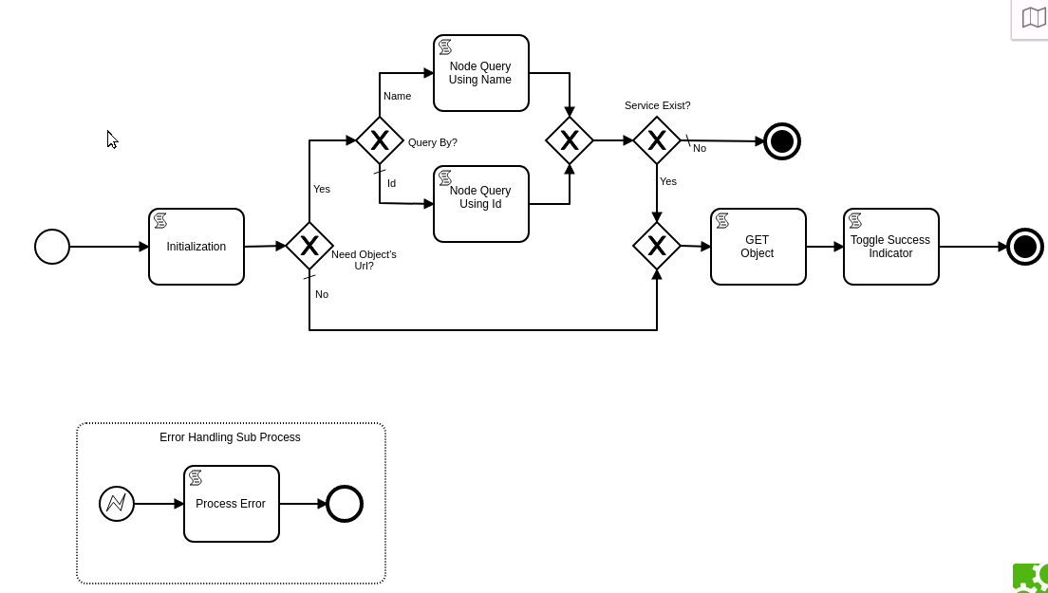
GenericGestService.bpmn level 3
#{execution.getVariable("GENGS_obtainObjectsUrl" ) == true}

Slide 12
Useful tools
Camunda Modeler
Camunda Cockpit https://camunda.com/products/cockpit/
http://www.bpmb.de/index.php/BPMNPoster

